Slide 1
Highway to Well(being):
Pathways to Delivering Yoga within a Whole Health System
Alison M. Whitehead, MPH, C-IAYT, E-RYT 200, RYT-500
VA Office of Patient Centered Care and Cultural Transformation
Francesca M. Nicosia, PhD, C-IAYT, CIYT, E-RYT
San Francisco VA Healthcare System
Marlysa Sullivan, DPT, C-IAYT, E-RYT 500
Atlanta VA Healthcare System
Rashmi Mullur, MD, RYT-200
Greater Los Angeles VA Healthcare System
Notes:
Topic Outline (150 words)
Introduction of VHA policy and pathways for yoga delivery in VHA to support access to the practices
Discussion of the processes for hiring yoga teachers and yoga therapists for independent practice and as part of interdisciplinary care
Review of the continuum of integration of yoga which includes: individual clinical care (e.g. PT/ OT), interdisciplinary care teams (e.g. PT working with a yoga teacher to support pain education), and standalone yoga or yoga therapy programs.
Exploration of the programs to support yoga as part of clinical care and interdisciplinary care teaches self-efficacy and confidence in the importance of the practices for on-going well-being
VHA national yoga teacher trainings and community of practice offer an opportunity for clinical staff to become leaders for how the frameworks of yoga integrates into whole person care while honoring the full breadth and depth of yoga
Processes to support yoga instructors and yoga therapists in VHA- Alison & Marlysa (10min)
Qualification standards and hiring of yoga professionals
Yoga professionals as independent practitioner and for integration in interdisciplinary care teams
Discussion of the VHA YTT: Marlysa & Rashmi: (10min)
Bridging yoga framework and practice to whole health models and person centered, trauma informed care.
Integrating the history and philosophy of yoga to support whole health in clinical care
Increasing access by offering multiple paths to participation in yoga. Francesca & Rashmi (10min)
Stand-alone classes, virtual delivery and access for rural Veterans
Introducing yoga within clinical care models
Supporting and Sustaining Yoga Professionals within VA: Marlysa (10min)
Training and community building
Concluding Remarks: Alison (5min)
Discussion (15min) – Note this is dedicated time for discussion though engagement will be prompted throughout the session

Slide 2
Disclaimer
The views expressed in this presentation are those of the presenters and do not necessarily reflect the position or policy of the Department of Veterans Affairs or the United States government.

Slide 3
Objectives
Understand the role of yoga within clinical care as a framework to explore goals supporting whole person health
Recognize the processes and standards to support yoga professionals within interdisciplinary healthcare teams.
Describe the landscape of yoga in VHA and the role of training in cultivating person-centered trauma-informed care and applications in other settings.

Slide 4
















Processes to Support Yoga Instructors and Yoga Therapists
Yoga Philosophy and Whole Health
Paths for Participation in Yoga
HIGHWAY TO WELL(BEING):
Pathways to Delivering Yoga within a Whole Health System
Training for Providers
Sustaining Yoga Professionals

Slide 5
Processes to Support Yoga Instructors and Yoga Therapists in VHA
Notes:
Alison and Marlysa – 10min

Slide 6
What has been developed: Pathways for Yoga in VHA
Supporting Yoga Teachers and Yoga Therapists in VHA as independent practitioners
Integration of yoga into clinical care for healthcare professionals who have scope and training to provide yoga as part of a Whole Health framework
Supporting clinicians working in interdisciplinary teams with yoga teachers and yoga therapists
Supporting needs of a healthcare system for best utilization of resources for both high-quality and essential Veteran care
Notes:
AW
Want to help yoga expand,
part of which would be through it being its own profession
Qual standards for yoga instructors and yoga therapists
Understanding of what these providers do (groups, 1:1)
Education for other staff
Consider how providers/clinicians with yoga training can incorporate yogic tools
E.g. Nurse (trained in yoga) providing yoga bedside with gentle movement, breath practices, meditation
Mechanisms to support yoga teachers and providers and other clinicians working together as interdisciplinary teams

Slide 7
Yoga Teachers and Yoga Therapists in VHA as Independent Practitioners
Qualification standards
Functional statements
Clinic guidance documents
Coding and tracking guidance (evolving)
  Benefit: Professionals dedicated to increasing the full breadth and depth of yoga throughout VHA and increasing equitable access to these services.
Notes:
AW

Slide 8
Why Qualification Standards for Yoga Instructor and Yoga Therapist?
Goal | Benefits
Provide a sustainment model for yoga in the VHA and support growth and professional development Whole Health System transformation sustainment to support clinical teams Professionals devoted to yoga delivery of sole duty versus collateral duty which allows for the delivery of the full scope of yoga consistently | Increased clarity for all individuals providing and supporting Yoga in VHA Increased flexibility in recruitment and staffing Decrease the need for community care referral Professionalization of the role of Yoga Instructor and yoga therapy Development of a professional community with shared standards
Notes:
AW

Slide 9
Benefit of Healthcare Providers Integrating Yoga into Clinical Care
Healthcare Professionals who have scope and training to provide yoga support
  Acceptability and understanding of Yoga as important in ongoing well-being through the introduction in clinical care.
  Supports self-efficacy for the practices
  Supports warm hand-off to yoga and yoga therapy as standalone, ongoing care
May be offered as practices integrated into clinical care, medical groups, limited specialized yoga classes
Notes:
MS
Healthcare professionals hired into other roles (not primarily as yoga teacher or yoga therapist) who have scope and training to provide yoga:
Integration of yoga into clinical care or medical groups
May teach a few specialized yoga classes as part of their duties
Clinicians serve an important role in accessibility and education about CIH practices and the whole health framework as they integrate yoga practices in clinical care within the scope of their licensed profession.
E.g. Nurse (trained in yoga) providing yoga bedside with gentle movement, breath practices, meditation

Slide 10
Why Yoga In Healthcare Settings?
Well known modality and widely practiced
Demand for non-pharmacologic approaches to pain and other conditions
Health benefits of yoga
Tools to develop / adapt practices to the individual and their needs
Supports management / self-care related to various conditions
Less invasive and costly than other interventions
Notes:
MS

Slide 11

Supporting Clinicians Working in Interdisciplinary Teams
Yoga Professionals can support the other clinicians through:
  Focus on autonomic regulation and resilience
  Focus on emotional and behavioral regulation and resilience
  Applying mindfulness and self-regulation to body awareness, movement, self-care strategies
  Supporting agency and empowerment for safe movement
Notes:
MS

Slide 12
VHA Yoga Teacher Training
Notes:
Marlysa and Rashmi (10min)

Slide 13
Structure of the Training
10 months
Meet once a month for 2 days (6.5 hours a day)
In between asynchronous work that consists of
  Yoga practice
  Reflections and meditations
  Didactics
Notes:
MS

Slide 14
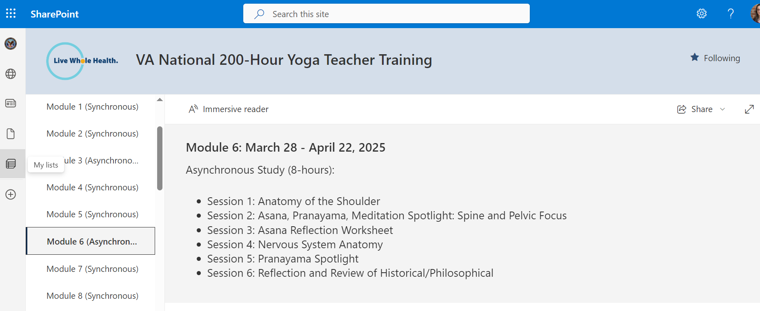
Notes:
MS

Slide 15
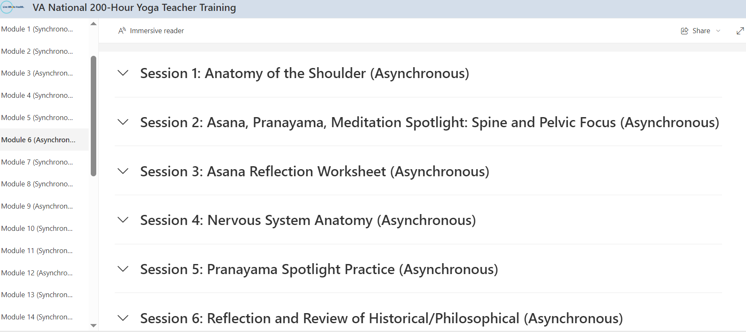
Notes:
MS

Slide 16
Yoga Philosophy to Support Whole Health Clinical Care
Notes:
Reason and understanding of philosophy and history are important
Having teachers knowledgeable on the philosophy will benefit teachers who may struggle with how to communicate and apply the benefits of yoga on the layers of experience to a complex and vulnerable population. This supports whole health message and allows for the adaptations of the practices to the person
If you understand why you can modify
It is important to teach these yoga frameworks so teachers at VA can help Veterans navigate barriers to implementation and support a whole health clinical care model.
H

Slide 17
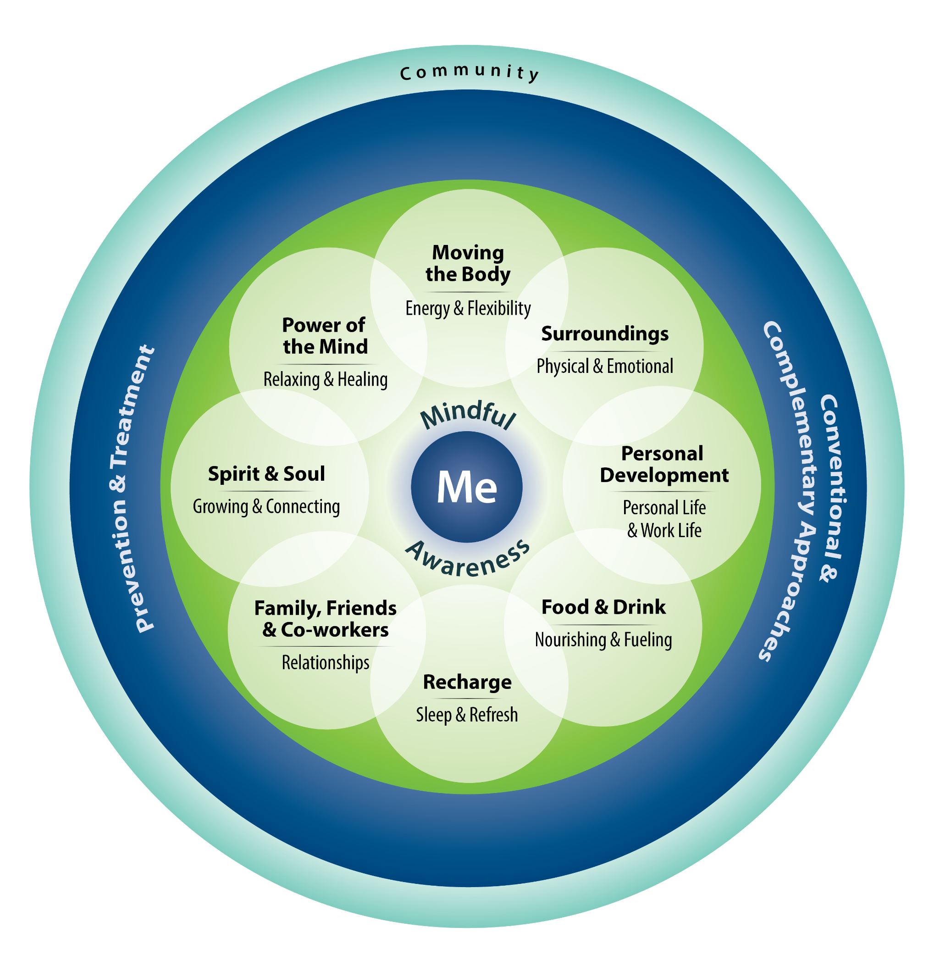
8 Limbs and Whole Health
Yoga
Social Disciplines
Yamas
Personal Disciplines
Niyamas
Postures/ Movement balancing effort and ease
Asana
Breathing Practices
Pranayama
Meditation stage: focused concentration
Dharana
Meditation stage: open monitoring Dhyana
Meditation stage: total Absorption
Samadhi
Withdrawal of senses: Pratyahara
Notes:
MS
Teachers at the VA are using this to….
All 8 limbs apply to all self-care areas. The 8 limbs instruct about the behaivoral changes in all the areas that people can make to support their self care—what you observe, abstain from , what you focus the mind on—they all focus on the self care areas. All 8 limbs support behavior change
Not that asana is moving the body—but asana moves the body, helps with personal development, supports recharge, relationships and social connection as you can walk with friends, connection to self
Moving the body—all 8 limbs for moving the body
Recharge—all 8 limbs help with recharge– moderation,
Ashtanga: 8 limbs—yoga as a comprehensive system of movement, breathing, meditation, connection o values
Here is an exercise we did with Yamas and Niyamas
Consider one Yama or Niyama a week
How it relates to one’s own values and purpose (developed previously)
Consider how it relates to a self-care area from circle of health

Slide 18
8 Limbs and Whole Health
Yoga
Social Disciplines
Yamas
Personal Disciplines
Niyamas
Postures/ Movement balancing effort and ease
Asana
Breathing Practices
Pranayama
Meditation stage: focused concentration
Dharana
Meditation stage: open monitoring Dhyana
Meditation stage: total Absorption
Samadhi
Withdrawal of senses: Pratyahara

Slide 19
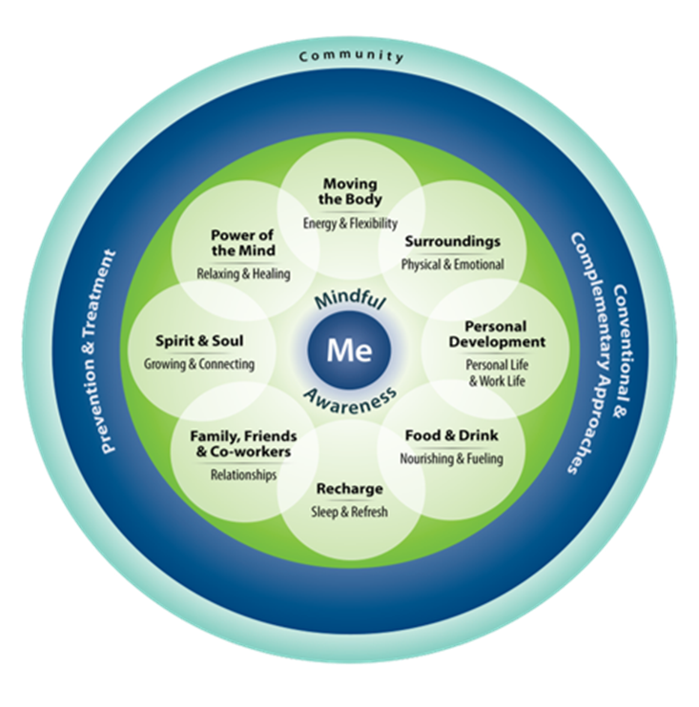
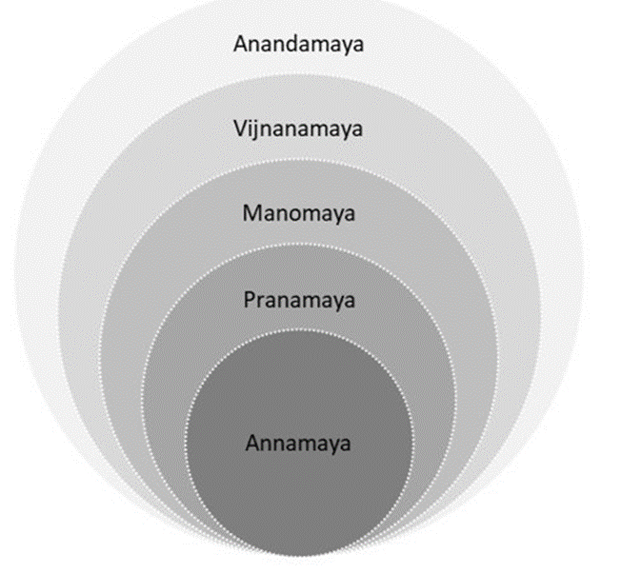
Koshas and Whole Health
Notes:
MS
Teachers at the VA are using this to….
Koshas- Layers of experience–
First layer of ourselves—but then the greater connectivity with each other
Anna→ body
Prana→ breath, but more subtle—bridge between mind and body
Interoception can fall in here-care with which we teach interoception to chronic pain—this link between mind and body—
Mano→mind

Slide 20
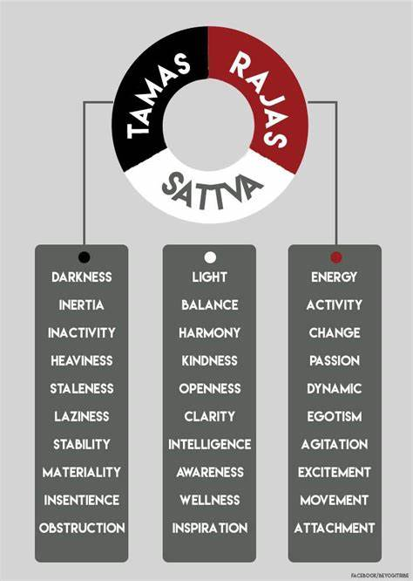
Gunas
Polyvagal Theory and Gunas worksheet
  Track the neural platforms and gunas in the pattern of the breath, thoughts and emotions, body tension
  Create a plan for regulation
  Application for yoga teachers at the VA
Notes:
Marlysa
Gunas: qualities of the mind, body, environment

Slide 21
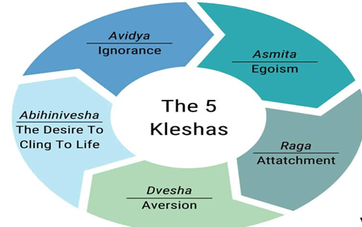
Understanding Barriers in Yogic Practice
In Yogic Philosophy, the Kleshas represent the primary barriers that block spiritual growth
Understanding barriers allows instruction to foster moving from a fixed to a growth mindset
Notes:
Avidya—Lack of insight into causes of suffering
Asmita—Ego-centrism prevents true connection to self (spiritual, secular) or others
Raga—Attachment to desire fulfillment
Dvesha—Avoidance of displeasure—including emotions, pain
Abhinivesha—fear of death & change

Slide 22
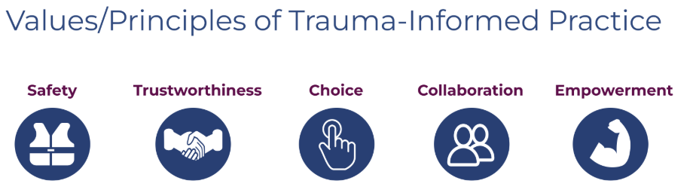
Yoga Philosophy and Trauma-Informed Care
Teaching Yoga philosophy principles (8 Limbs, Koshas, Gunas, Kleshas) provides VA Yoga instructors with insights to better serve Veterans
Alignment with principles of Trauma-Informed Care
The philosophical concepts inform:
  Exploring the lived experience of chronic illness
  Coping/resilience skills
  Connecting to well-being
Notes:
Reference: Institute on Trauma-Informed Care
Ensuring physical and emotional safety --
Respectful and professional boundaries are maintained --
Individual has choice and control --
Making decisions with the individual and sharing power --
Prioritizing empowerment and skill building --

Slide 23
Introducing Yoga within Clinical Care Models
Setting expectations regarding health outcomes with yoga
  Healthcare Professionals vs. Yoga Professionals
  Specificity and generalizability of outcome(s)
  Need for concomitant therapeutic lifestyle change
Disease-specific postures
  Evidence vs. Myth
Modifications of instruction
  Safety and Interoception
  Virtual vs. Face to Face
  Supporting patients with disability
Discussion of yoga philosophy, the stress response and self-regulation
Notes:
Yoga and the lived experience of illness
Help someone cope and build resilience skills

Slide 24
Multiple Paths for Participation in Yoga
Notes:
Francesca and Rashmi – 10min
Stand-alone classes, virtual delivery and access for rural Veterans
Introducing yoga within clinical care models

Slide 25

Current Available Pathways for Patient Access to Yoga
In-person
  Outpatient:
    Group classes
      Drop-in
      Cohort
  Inpatient groups– (e.g., Mental Health Acute Recovery Center)
Virtual
  Synchronous Group Classes
  Asynchronous Recorded Videos
Well-being vs. Clinical care
  Well-being Groups widely available
  Clinical Care cohorts in development across VA
Notes:
We increase access and engagement in CIH/WH by having multiple opportunities for participation

Slide 26
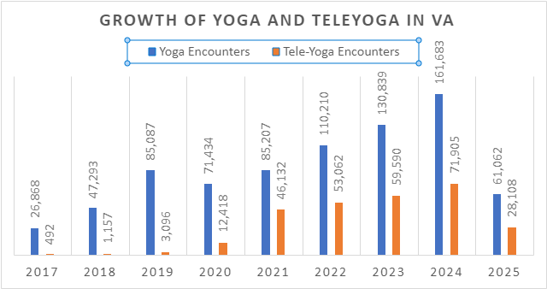

Slide 27



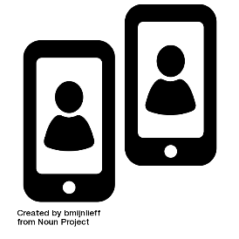

Success Factors for TeleYoga Implementation
  Synchronous Video-based Group Well-being Yoga Classes
EMR-based
Referral
Intake Call
Orientation
Yoga Props
Tele-Yoga Groups
Pham et al, GAIMH, 2024
Notes:
Our pilot program included the following components: an electronic medical records-based referral process (and a database to facilitate reporting on program metrics, and standardizing CPRS note titles).
We conducted intake calls where veterans to identify veterans’ goals and specific needs, followed by a virtual orientation session to facilitate technology and home set-up. Yoga props were provided as needed.
In contrast to a clinical trial for a specific health condition with a manualized protocol, the yoga groups in this program generally focused on wellbeing. Marlysa and Rashmi will talk later about yoga and mindful movement within clinical care. Yoga instructor background was also varied in terms of clinical roles and yoga training. We have a poster tomorrow focused on tele-yoga instructors. After the pilot year, the project expanded to include additional sites.

Slide 28
TeleYoga Program Reach (FY22-23)
6 Sites | 1091 Veterans | 11345 Encounters
Mean Encounters: 10.3
Mean Age: 57.1 ± 14.5
40% Women​ Veterans
21% Rural-dwelling
9% Hispanic or Latino
*VA Administrative Data
Notes:
Across the 6 sites, a total of 1091 veterans participated in at least one teleyoga group with over 11,000 total encounters. Demographically, participants were 57 years old on average, 40% women, and 21% lived in rural areas. Participants were also relatively diverse in terms of racial and ethnic background, especially when compared to demographics of yoga users in the US more broadly and also VA users, especially the proportion of black and African American veterans, which comprise 13% of VA patients whereas represented 22% of program participants.
The next few slides I’ll highlight some of the findings from our program evaluation which included a survey sent to all participants and completed by 207.

Slide 29
TeleYoga Program Survey Results
89%
Rated the convenience of TeleYoga as good to excellent
Reported that the online format made it “a great deal easier” to attend than an in-person VA Yoga class
68%
"As I live far away from any VA facility, the convenience is fabulous. I don't think I would have ever done yoga if VA hadn't offered it online.”
"You don’t have to feel uncomfortable if you don’t do the positions right. You don’t have to be self conscious about your body."
Notes:
We found that 89% of veterans rated the convenience of teleyoga as good to excellent. With 68% indicating that online was a great deal easier to attend than in person at a VA facility. Open ended responses and interviews elaborated on the convenience factor, especially decreasing travel burden and cost of attending community –based studio or gym class, if they were available in their area. Others talked about how they were less self-conscious when participating from home. For some Veterans with anxiety or post-traumatic stress, teleyoga also provided a psychologically safer way to be in a group movement class which they would otherwise not engage with in an in-person setting.

Slide 30
TeleYoga Program Survey Results
Rated their sense of personal connection with the TeleYoga instructor as good to excellent
Rated their sense of personal connection with the other TeleYoga participants as good to excellent
83%
63%
“The Yoga and interaction with the instructor makes me feel like I have purpose.”
"For the most part, it is the only connection that I have with the VA. Honestly, my yoga instructor is the only VA person that seems to give a s**t about me."
Notes:
We asked veterans about their sense of personal connection with yoga instructors and other tele-yoga participants. 88% rated their connection with their yoga instructor highly. While not as high, close to two thirds had at least a good connection with other participants in the virtual setting, which is notable given the limitations of the virtual setting to develop meaningful connections during a movement-based group. Open-ended responses highlighted how for some veterans, their tele-yoga instructor was the only connection they have with the VA and a key reason that they continued with classes.
In interviews, Veterans described how, even if they did not engage in conversation with other class participants, they still appreciated being part of a community and experienced decreased isolation.

Slide 31
TeleYoga Program Survey Results
Participants agreed that taking TeleYoga helped them…
83%
Exercise and Move More
Reduce Stress
Improve Mood
74%
71%
Reduce Pain
Improve Mental Health
61%
66%
“Once I started, I was walking taller, able to use breathing to calm my panics, and became stronger. It also helps me with chronic back pain.”

Slide 32
TeleYoga Program Survey Results
Participants agreed that taking TeleYoga helped them…
Engage in Their Personal Healthcare
78%
“Exercising me AND my commitment to better overall health!”
“I have lost weight for it has motivated me to exercise.
My overall health has improved tremendously.”
“I'm excited to improve my health while attending classes.”
Notes:
Participants also reported that taking teleyoga helped to engage in their personal healthcare.

Slide 33
Survey Results: Association of Device Size and Drop-out
Veterans who dropped off after one encounter were significantly more likely to have used a smaller device.
p = 0.004
Notes:
We also asked Veterans what kind of device they used to join teleyoga groups and when comparing device screen size, veterans that dropped off after only one encounter were significantly more likely to have used a tablet or phone versus a laptop, desktop, or screencasting to a TV compared to those with two or more encounters (38%, p-= 0.004).

Slide 34
Older and rural- dwelling Veterans had significantly higher encounters and were less likely to discontinue after one encounter.
Results: Age and Geographic Location
Mean Encounters (n=1091)
Age
Rurality
p = 0.001
p = 0.002
≥65
<65
Rural
Urban
Notes:
When we compared mean encounters between demographic groups within our overall participant sample of 1091, we found that participants over 65 years of age and living in rural locations significantly higher encounters after controlling for age and rurality, . These groups were also less likely to discontinue teleyoga after only one encounter. Older veterans, tend to be retired and daytime classes easier to attend than working individuals. For those living in rural locations, this was nice tosee since we know that the availability of community based yoga is less prevalent in many rural areas and VA access provided important access.
==
higher TeleYoga engagement was associated with rural residence (mean 12.6 vs. 9.1 encounters, p=0.002) and older age (65+, mean 16.2 vs. 6.9 encounters, p<0.001).
Rural and older Veterans were also significantly less likely to discontinue TeleYoga after just one encounter (rurality: p= 0.004; age: p=0.002).

Slide 35
Lessons Learned from TeleYoga Instructors
Audio-Visual Needs
Large monitor High resolution webcam Wireless microphone headset Adequate lighting
Training Needs
Adaptive yoga – mobility and neurologic status Trauma-informed principles Adjusting instruction for patient-specific needs in real time
Physical Space
Enough space for full-body view Quiet and private
Administrative
Scheduling, documentation, sending class links Online orientation and onboarding new patients Technology support during class
Notes:
Yoga-for-wellness group classes in VA are heterogenous, meaning that participants may present with varying complex health conditions and needs and mobility levels.

Slide 36
Supporting and Sustaining Yoga Professionals
Notes:
Marlysa (10min)
Training and community building

Slide 37
Supporting Yoga Professionals
Yoga Community of Practice
1:1 consultations with facilities and professionals
Considering ways to build community for those hired as yoga professionals

Slide 38
Processes to Support Yoga Instructors and Yoga Therapists
Yoga Philosophy and Whole Health
Paths for Participation in Yoga
HIGHWAY TO WELL(BEING):
Pathways to Delivering Yoga within a Whole Health System
Training for Providers
Sustaining Yoga Professionals
Notes:
-Need to maintain / strengthen where we are
What are some of the pathways your institution is developing for provision of yoga?
Have you done anything differently that has been successful you would like to share?
Where would you like to see yoga and yoga therapy headed at your institution?
Anything else you would like to share or ask?

Slide 39
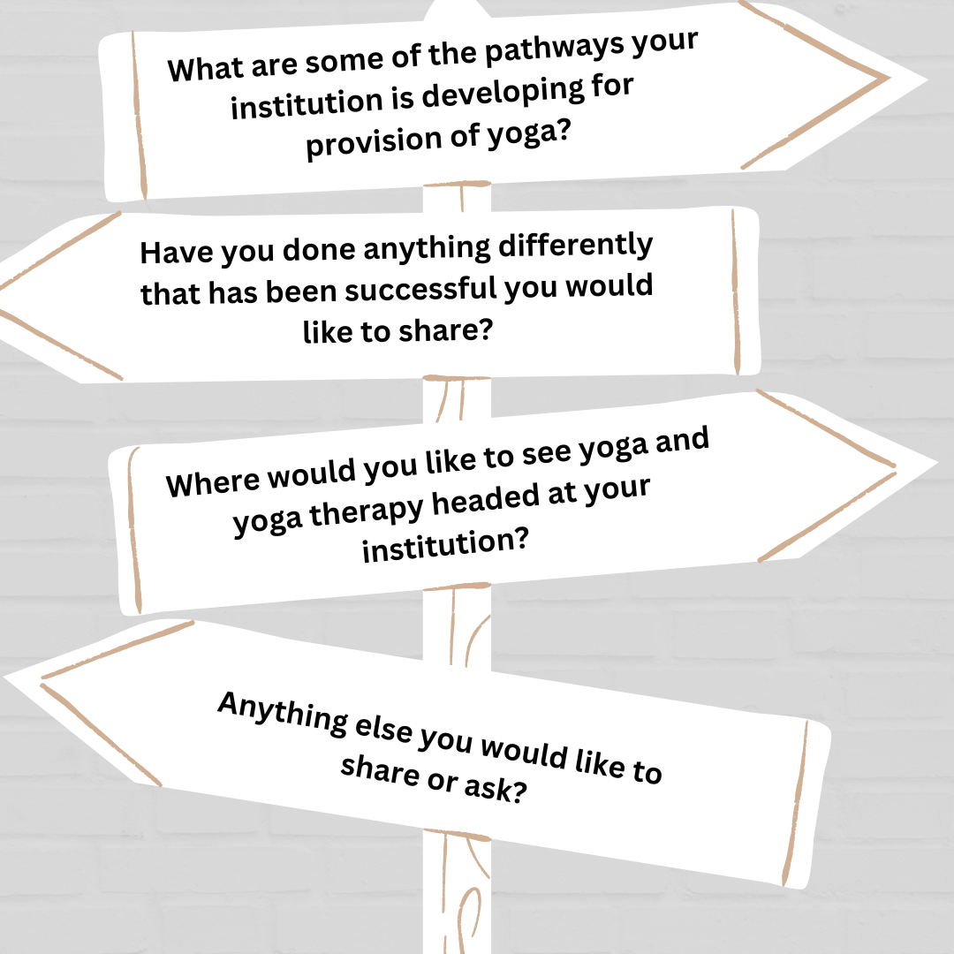
Open Discussion
Notes:
Discussion (15min) – Note this is dedicated time for discussion though engagement will be prompted throughout the session

